Slide 1
CARKILA
Vehicle Rental Mobile Application
Martha Salamat
Justin Omac
Brian Olores John Ryan Pasaoa

Slide 2
Software Requirements Specification

Slide 3
 | ASSIGNED TO | YES | NO | REMARKS
Output The mobile application must provide a report on the following: frequently requested vehicle, days of the week when vehicle is commonly requested. The mobile app must generate a review on the renter and on the car owner with a review and rating from 0 to 5 stars. The mobile application will provide a detailed list of the vehicle owner, the year and make of the vehicle, a recommended vehicle. The app will display only vehicles that are available within the rent date/time specified by the car renter. The mobile application must show the car details including: images make model year seating capacity color The app must show the contact information of the car owner and the car renter. The application must display to the car owner the chosen rent date and time to the car renter. The application must display to the vehicle owner the chosen location of the renter.

Slide 4
 | ASSIGNED TO | YES | NO | REMARKS
Input Car owners and car renters can sign up/sign in in the app by using their email or Facebook login credentials. Car owners and car renters must input their personal information: Full name Address Sex Age Birth date Mobile Number Email License number (if driver) Car owners must input their car details including: Images of the vehicle (front, back, both sides, left, and right) Make Year and model Manufacturers recommended seating capacity Color Plate number OR and CR License Car owners must set their availability schedule. Car owners must upload the necessary documents via a clear picture or a clear scan. These documents include: Driver’s License The Official Receipt/Certification of Registration of the vehicle LTFRB accreditation (franchise) Car renters must include their trip details: Pick-up location Destination Time (from-to) Date (from-to) Number of Passengers

Slide 5
 | ASSIGNED TO | YES | NO | REMARKS
Process The system must notify the car owner if someone requests his/her car. The system must notify the car renter if the car owner accepted his/her request. The system must be able to locate nearest cars to the user. The system must be able to find cars based on the preferences of the car renters. Performance The mobile application must be available 24/7. The system must notify the car renters within 10 minutes after the car owner accepted/declined the request The response time or car renters to the notification must not exceed 5 seconds. The mobile application must work on all Android phones. Control Only the administrator can generate the reports.

Slide 6
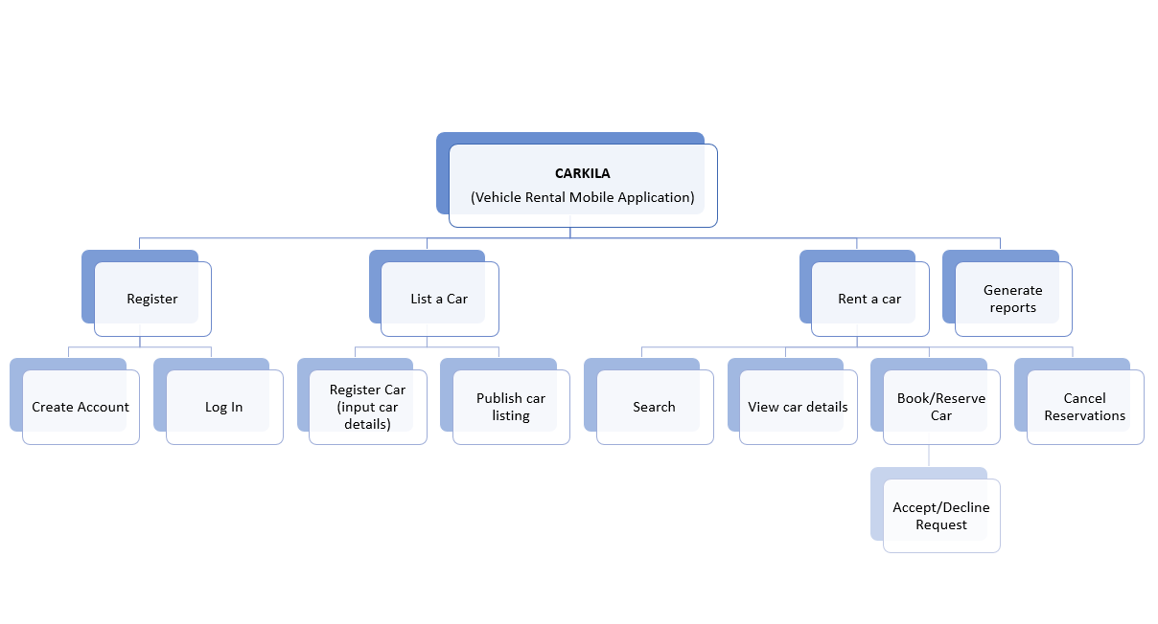
Functional Decomposition Diagram

Slide 7
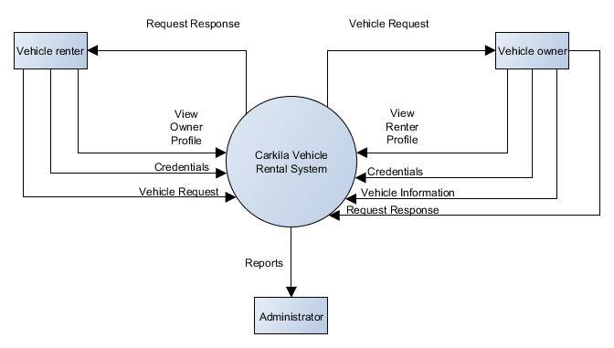
Data Flow Diagram: Context Diagram

Slide 8
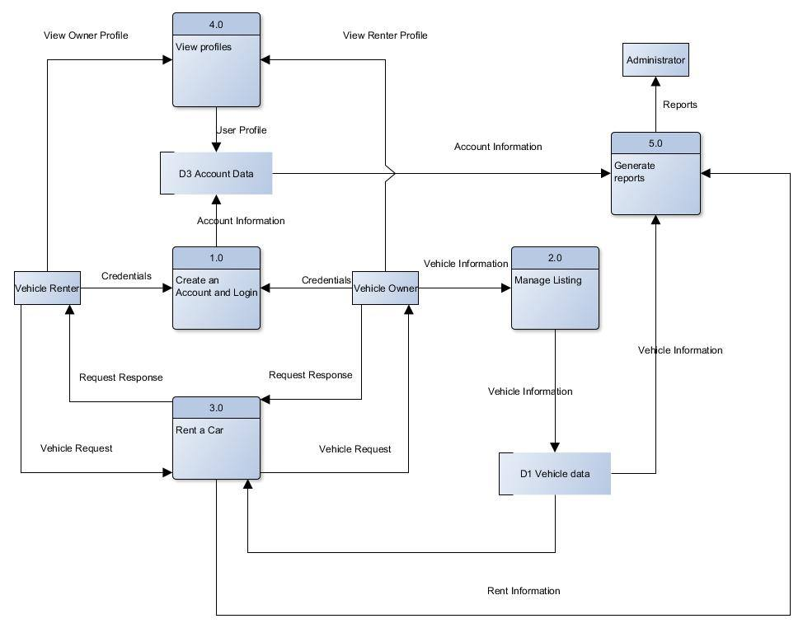
Data Flow Diagram: Level 0

Slide 9
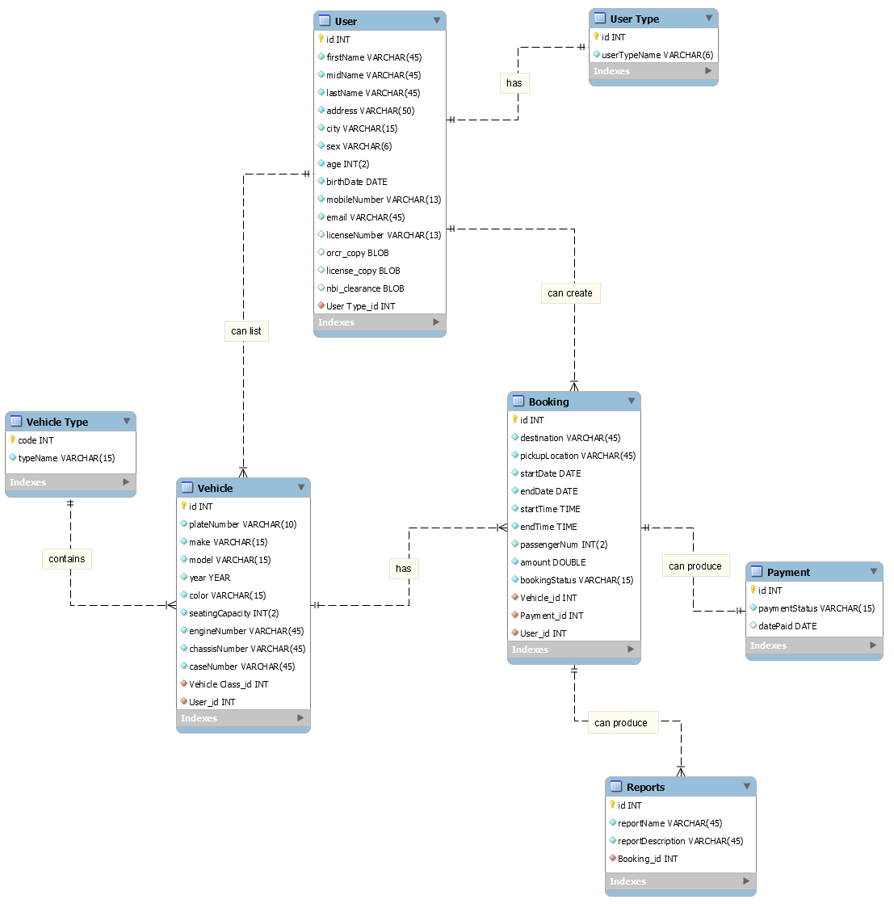
Entity Relationship Diagram

Slide 10
Data Dictionary

Slide 11
TABLE: User
Field Name | Data Type | Field Length | Constraint | Description
id | INT |  | Primary Key | User ID, Auto-generated
firstName | VARCHAR | 45 | Not Null | First Name
midName | VARCHAR | 45 | Not Null | Middle Name
lastName | VARCHAR | 45 | Not Null | Last Name
address | VARCHAR | 45 | Not Null | Address
city | VARCHAR | 2 | Not Null | City
sex | VARCHAR | 6 | Not Null | Sex
age | INT | 2 | Not Null | Age
birthdate | DATE |  | Not Null | Birth Date
mobileNumber | VARCHAR | 13 | Not Null | Mobile Number
email | VARCHAR | 45 | Not Null | Email Address
licenseNumber | VARCHAR | 13 | Null | License Number
orcr_copy | BLOB |  | Null | Photocopy of Vehicle OR/CR
license_copy | BLOB |  | Null | Photocopy of Driver’s License
nbi_clearance | BLOB |  | Null | Photocopy of NBI Clearance
User Type_id | INT |  | Foreign Key | User Type ID

Slide 12
TABLE: Booking
Field Name | Data Type | Field Length | Constraint | Description
id | INT | 11 | Primary Key | Booking ID, Auto-generated
destination | VARCHAR | 45 | Not Null | Destination
pickupLocation | VARCHAR | 45 | Not Null | Pickup Location
startDate | DATE | 45 | Not Null | Trip Start Date
endDate | DATE |  | Not Null | Trip End Date
startTime | TIME |  | Not Null | Trip Start Time
endTime | TIME |  | Not Null | Trip End Time
passengerNum | INT | 2 | Not Null | Number of Passengers
amount | DOUBLE | 11 | Not Null | Amount of Rental
bookingStatus | VARCHAR |  | Not Null | Booking Status
Vehicle_id | INT |  | Foreign Key | Vehicle ID
Payment_id | INT |  | Foreign Key | Payment ID
User_id | INT |  | Foreign Key | User ID
TABLE: User Type
Field Name | Data Type | Field Length | Constraint | Description
id | INT |  | Primary Key | Payment ID
userTypeName | VARCHAR | 6 | Not Null | Payment Status

Slide 13
TABLE: Vehicle
Field Name | Data Type | Field Length | Constraint | Description
id | INT |  | Primary Key | Vehicle ID, Auto-generated
plateNum | VARCHAR | 45 | Not Null | Vehicle Plate Number
make | VARCHAR | 45 | Not Null | Vehicle Make
model | VARCHAR | 45 | Not Null | Vehicle Model
year | YEAR |  | Not Null | Vehicle Year
color | VARCHAR | 15 | Not Null | Vehicle Color
seatingCapacity | INT | 2 | Not Null | Vehicle Seating Capacity
engineNumber | VARCHAR | 45 | Not Null | Vehicle Engine Number
chassisNumber | VARCHAR | 45 | Not Null | Vehicle Chassis Number
caseNumber | VARCHAR | 45 | Not Null | Franchise Case Number
rentalRate | DOUBLE |  | Not Null | Vehicle Rental Rate
Vehicle Type_id | INT |  | Foreign Key | Vehicle Type ID
User_id | INT |  | Foreign Key | User ID

Slide 14
TABLE: Reports
Field Name | Data Type | Field Length | Constraint | Description
id | INT |  | Primary Key | Report ID
reportName | VARCHAR | 45 | Not Null | Report Name
reportDescription | VARCHAR | 45 | Not Null | Report Description
Booking_id | INT |  | Foreign Key | Booking ID
TABLE: Vehicle Type
Field Name | Data Type | Field Length | Constraint | Description
Code | INT |  | Primary Key | Vehicle Type Code
typeName | VARCHAR | 15 | Not Null | Vehicle Type Name
TABLE: Payment
Field Name | Data Type | Field Length | Constraint | Description
id | INT |  | Primary Key | Payment ID, Auto-generated
paymentStatus | VARCHAR | 15 | Not Null | Payment Status
datePaid | DATE |  | Null | Date Paid

Slide 15
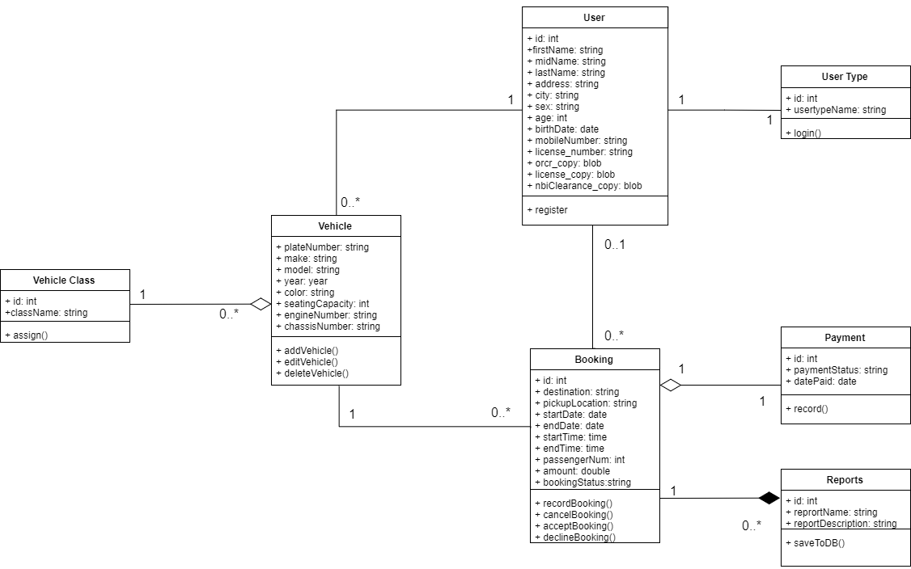
Class Diagram

Slide 16
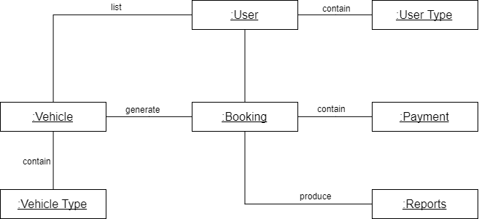
Object Diagram

Slide 17
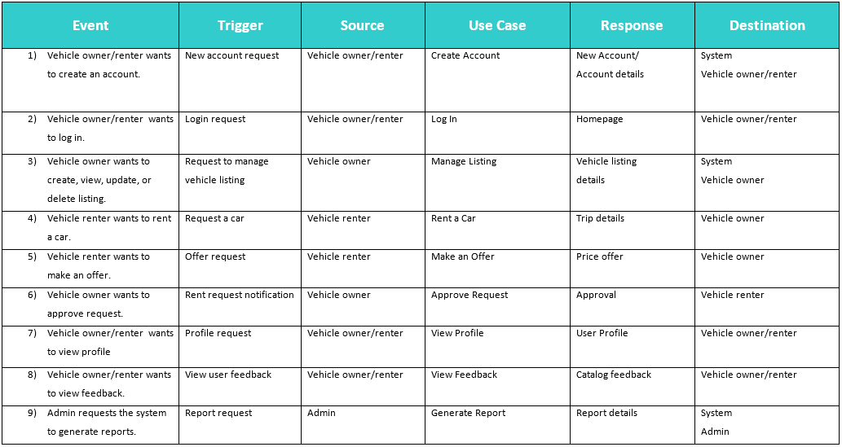
Event Table

Slide 18
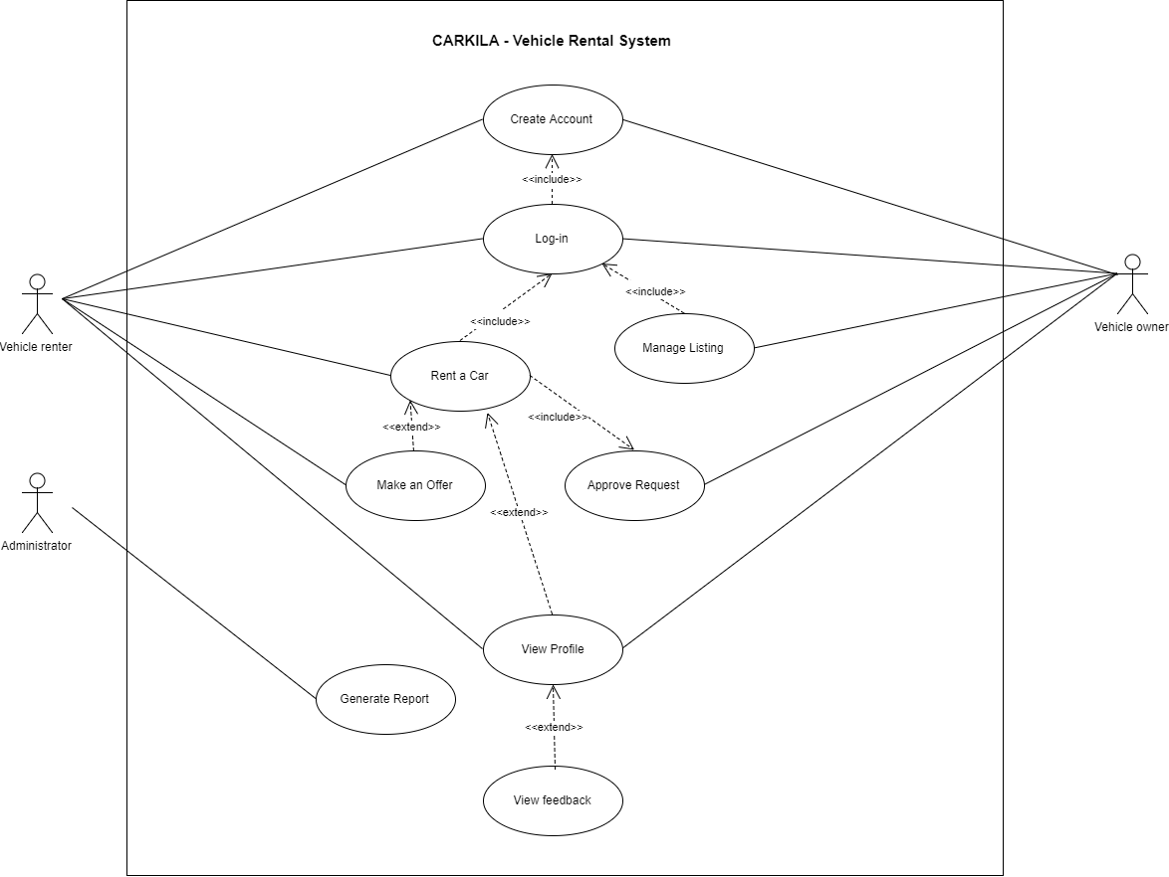
Use Case Diagram

Slide 19
Use Case Full Description

Slide 20
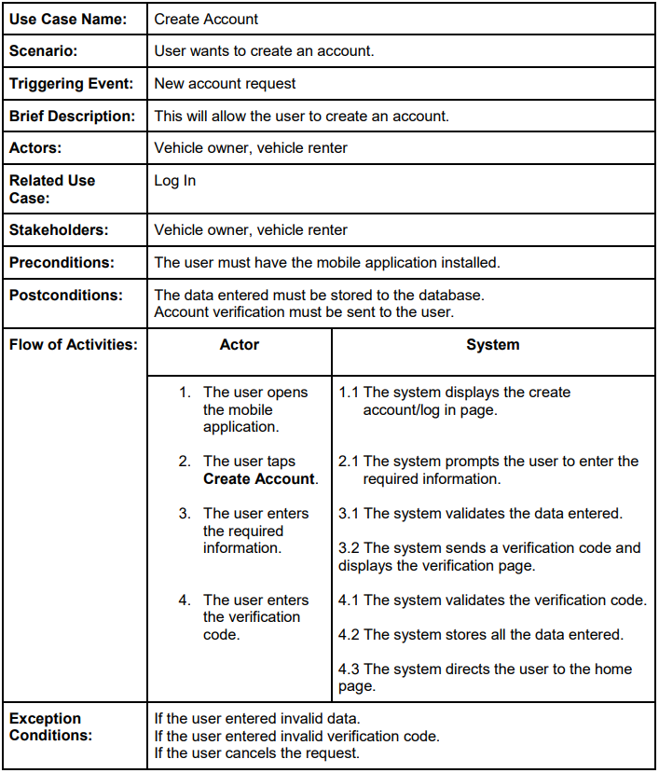

Slide 21
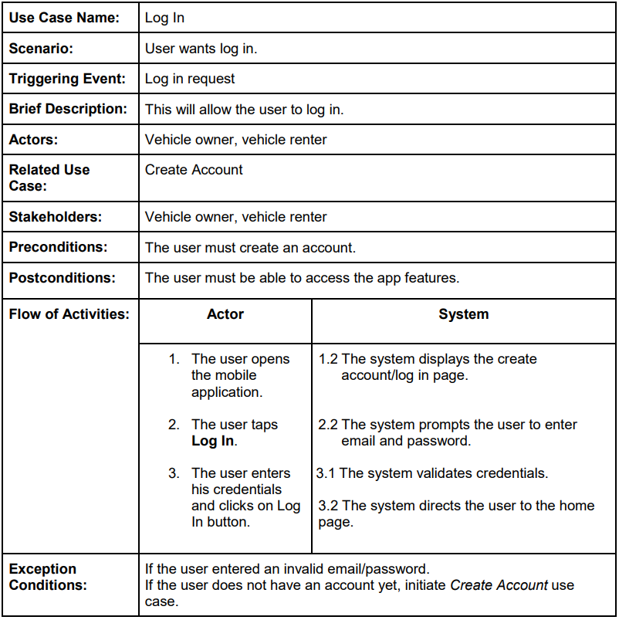

Slide 22
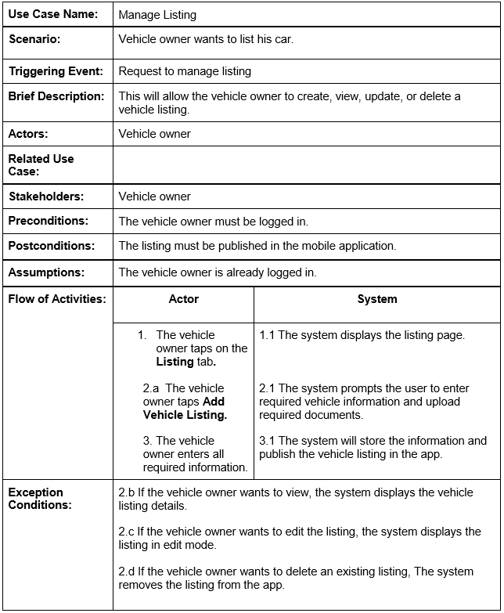

Slide 23
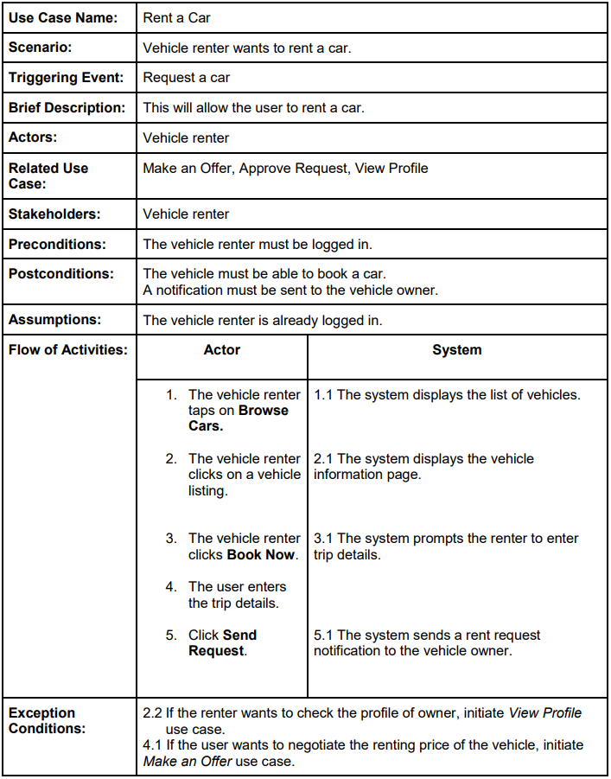

Slide 24
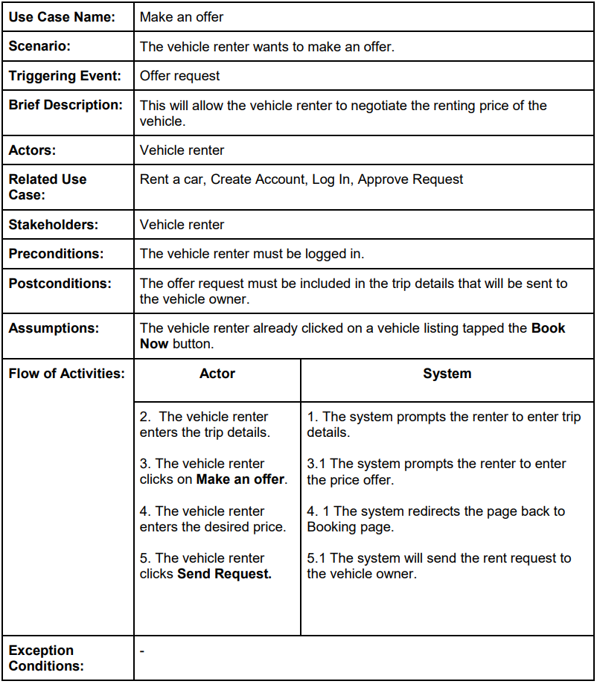

Slide 25
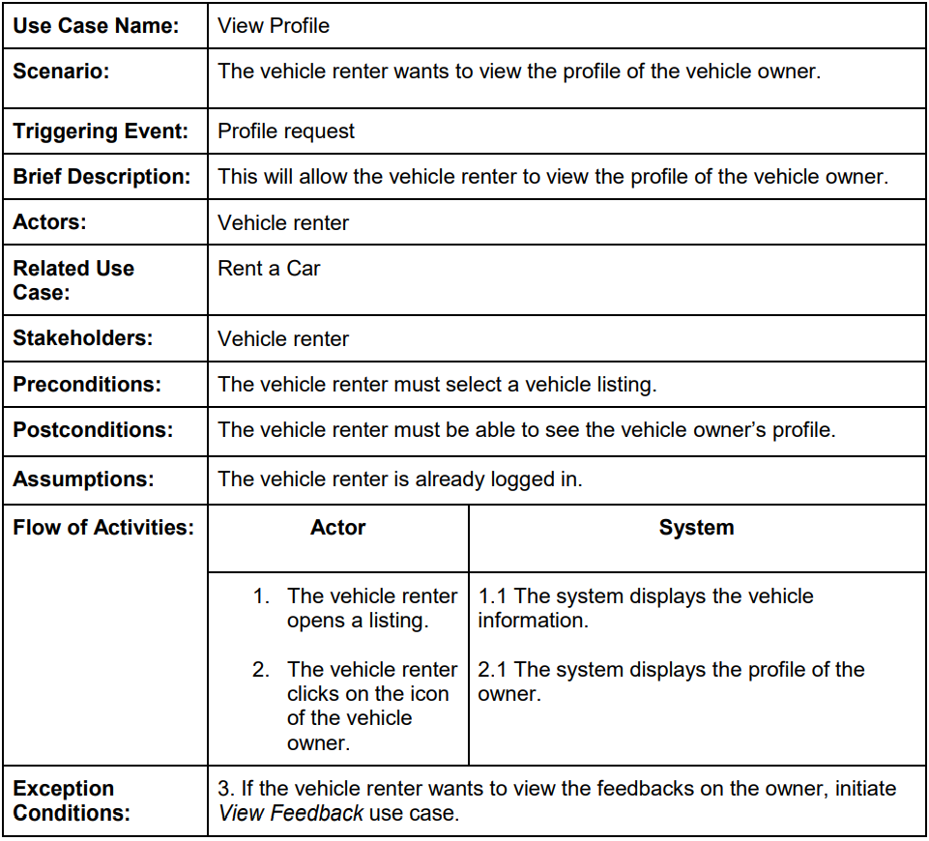

Slide 26
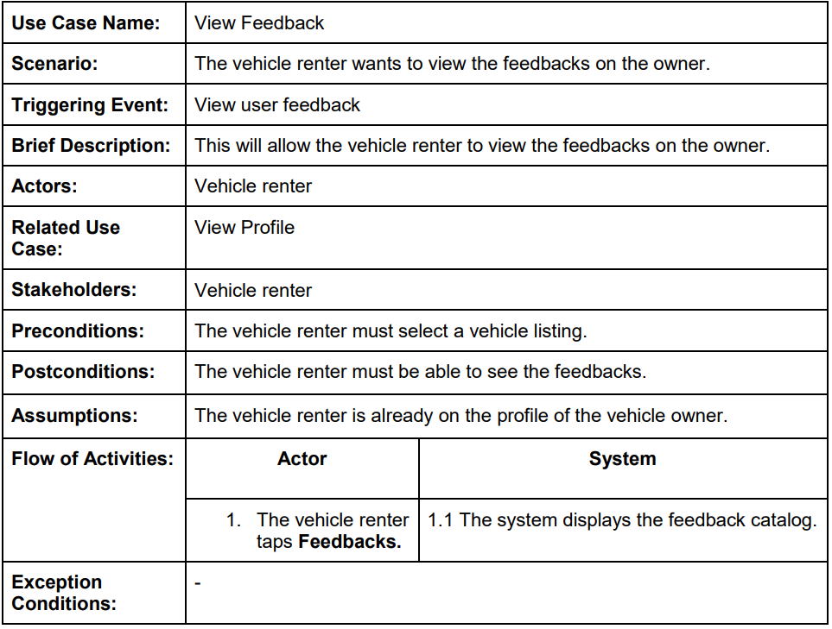
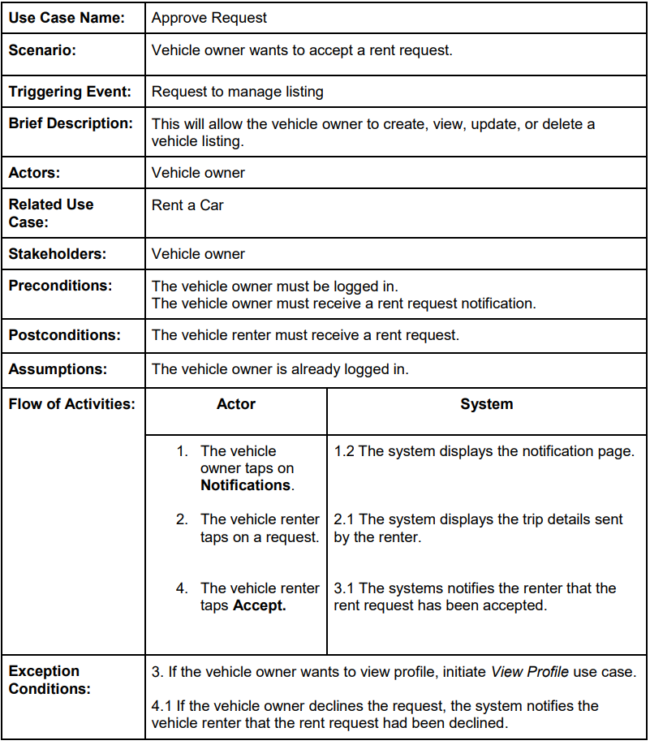

Slide 28
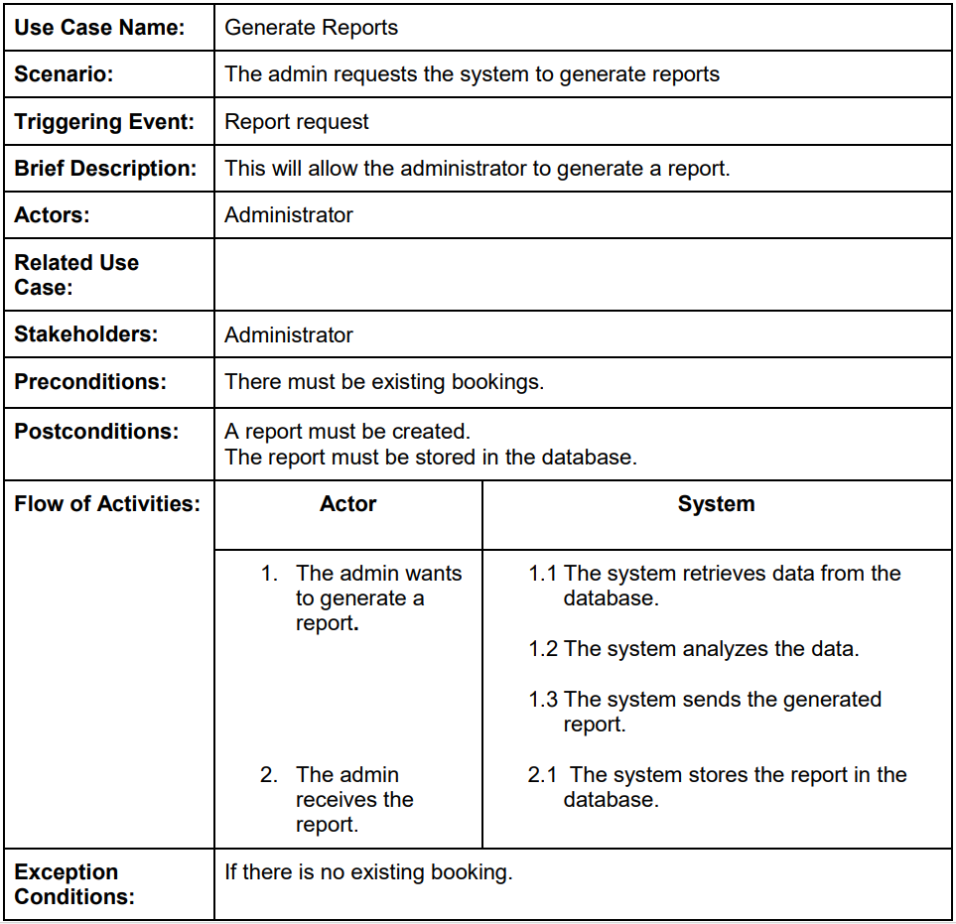

Slide 29
Activity Diagram

Slide 30
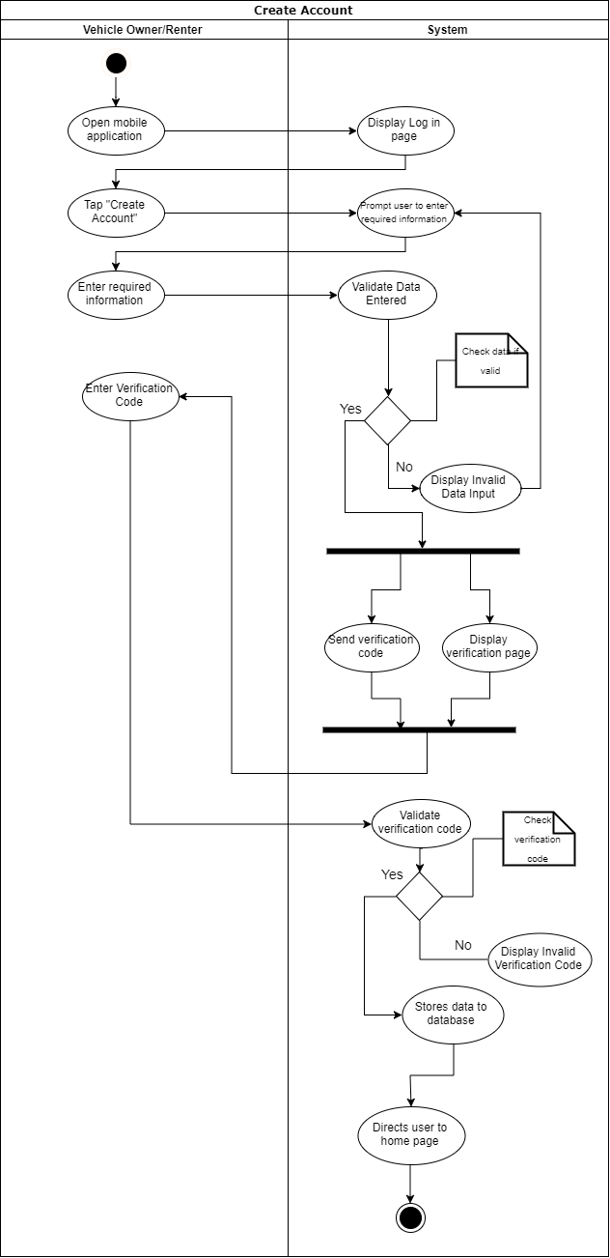
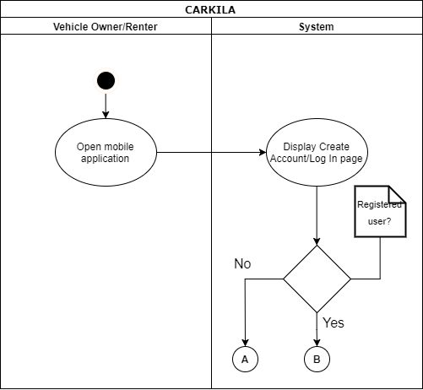
A

Slide 31
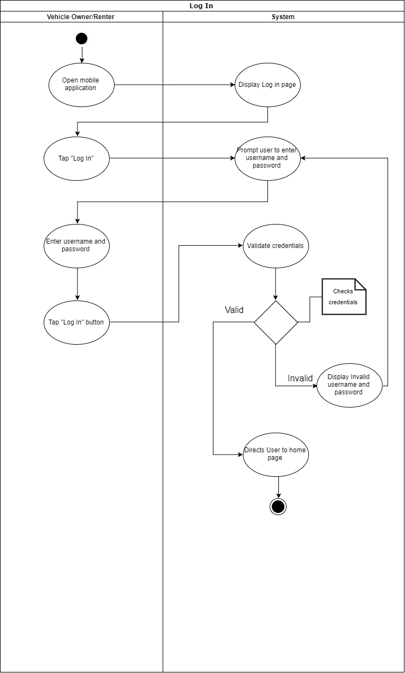
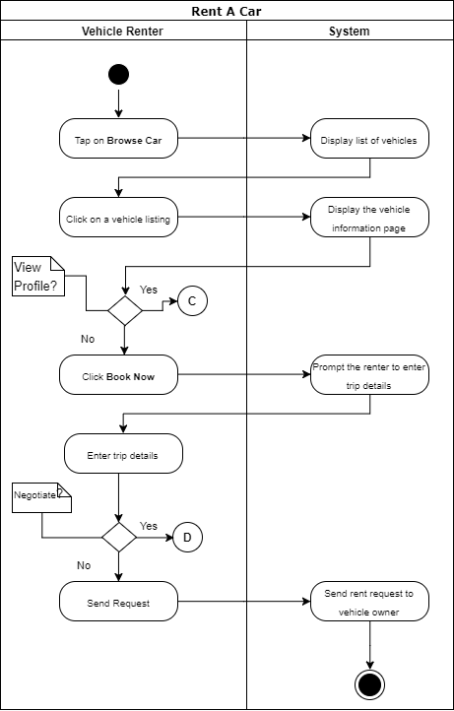
B

Slide 32
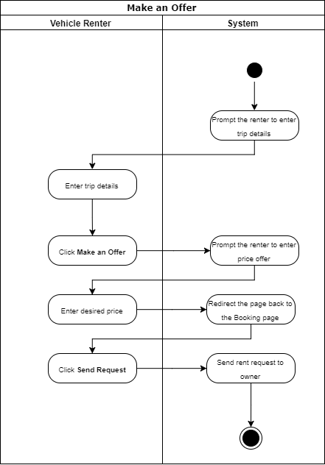
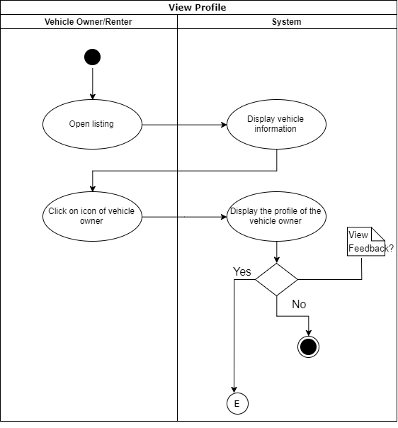
C
D

Slide 33
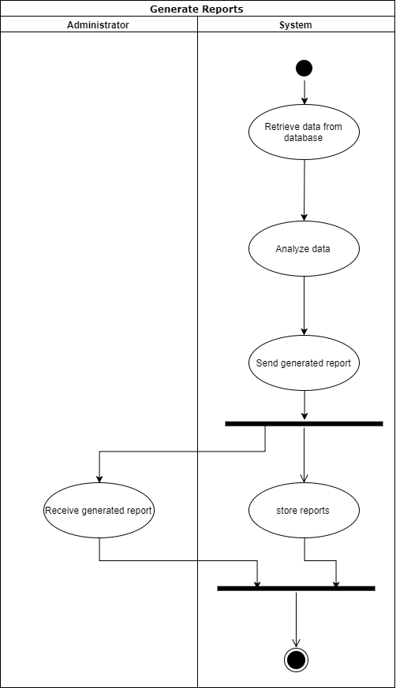
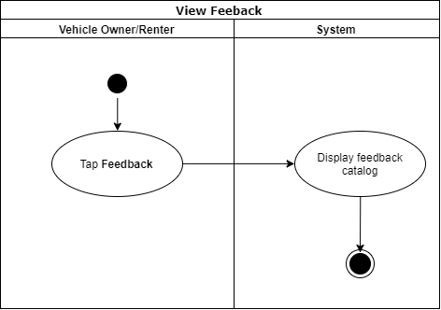
E

Slide 34
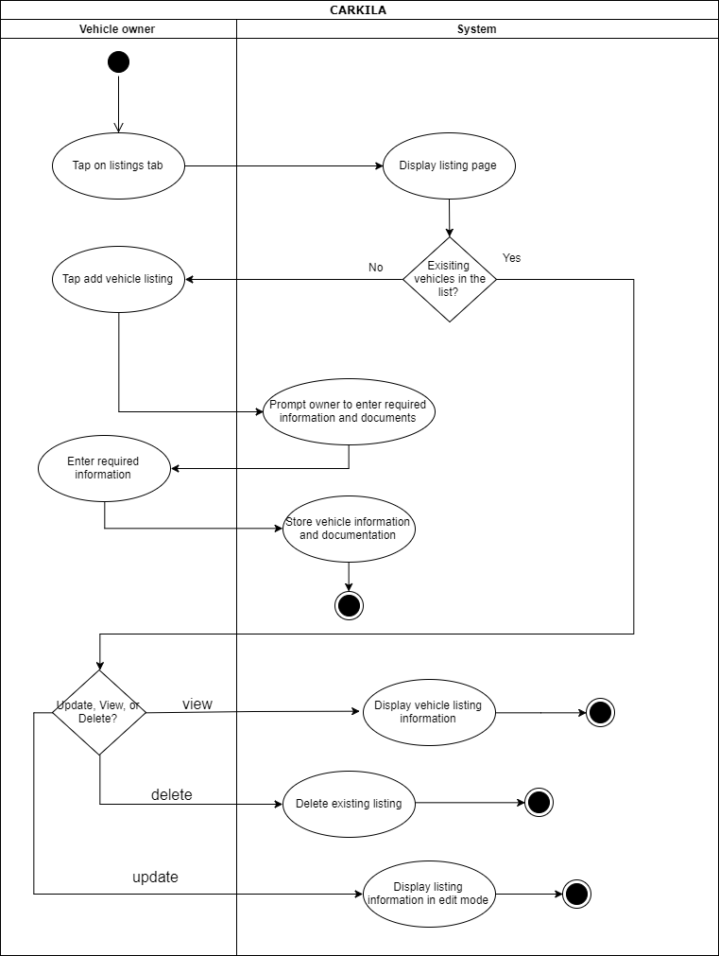

Slide 35
Sequence Diagram

Slide 36
